Slide 1

Stock Predication
(RNN and LSTM ) Prepared by Atul Bachhav & Kevin Arawattigi

Slide 2
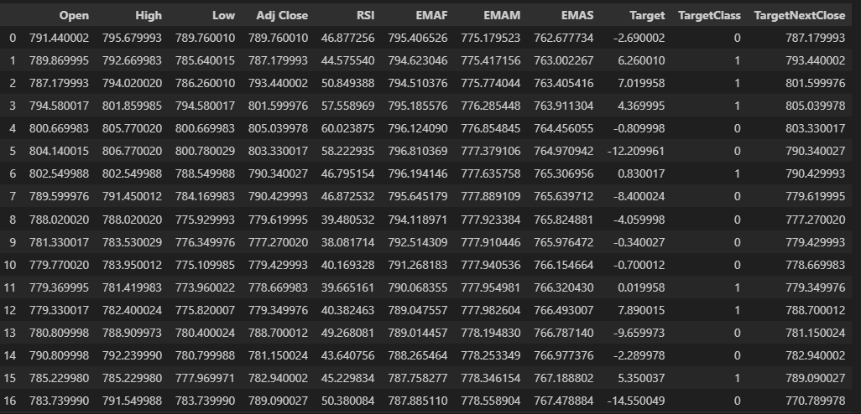
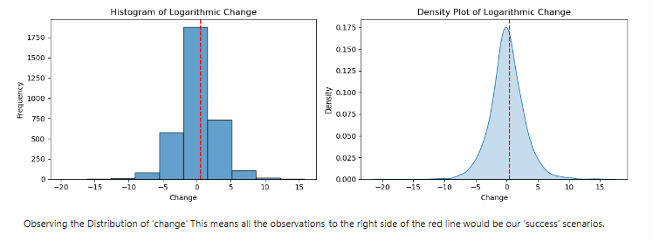
Data Preparation and Analysis
Predict percentage increase in the value of the stock at close.
Define our target variable as an increase larger than 0.5% (so that it’s worthwhile to make a purchase)
Use yahoo API to get historical stock data of various tickers.
Stock price from last 15 years
Feature List : Open , High , Low , Adj Close, RSI,EMAF, EMAM, EMAS
Output : TargetNextClose, TargetClass, Target

Slide 3
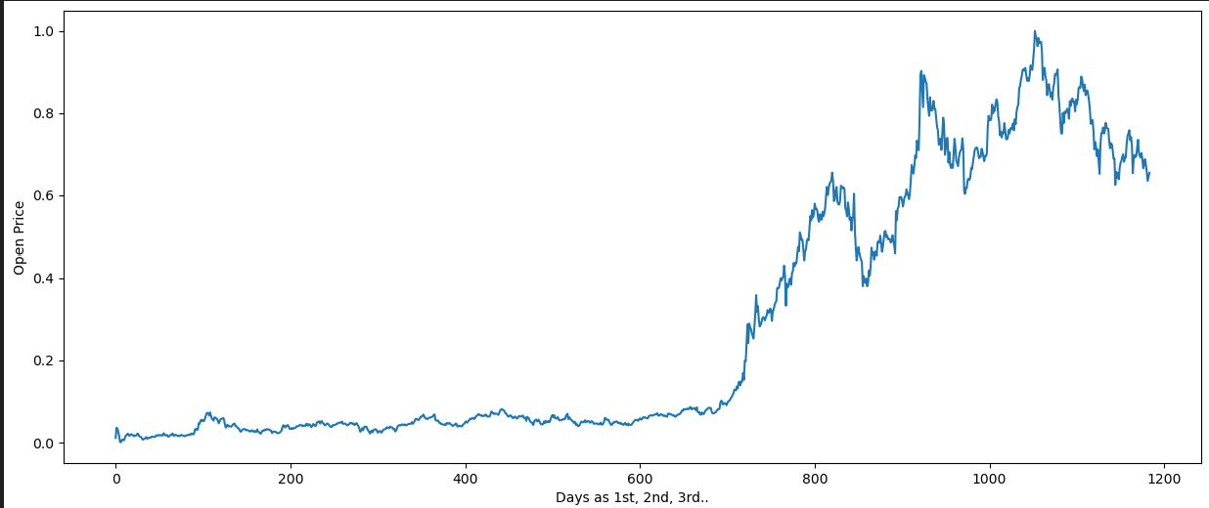
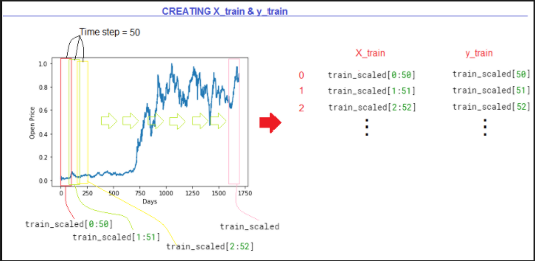
Data Splitting and Reshape

Slide 4
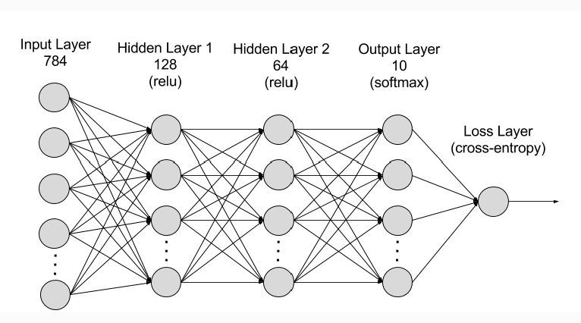
AI Model (RNN)
RNNs (Recurrent Neural Networks) are used for stock prediction because they are effective at processing sequential data, allowing them to capture temporal dependencies and patterns in time series data
Number of hidden layer used = 4
Input Sequence count = 50
Activation Function used = Tanh
Output layer = 1
Optimizer = Adam

Slide 5
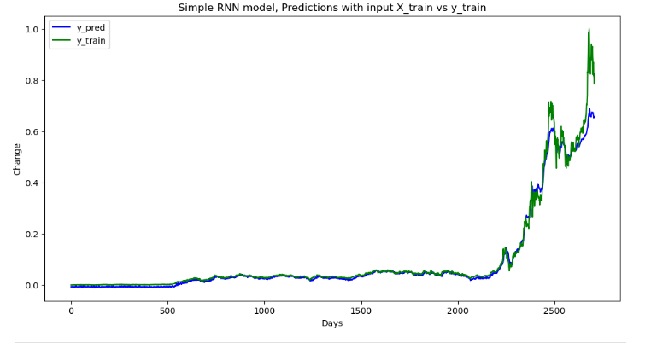
RNN Model Evaluation

Slide 6
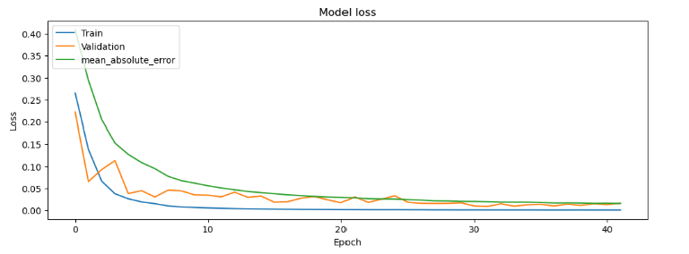
Model Loss

Slide 7
Model Tuning
Added input feature RSI,EMAF, EMAM, EMAS
Changes Epoch cycles
Changes sequence Time span 30, 40 , 50
Predict the multiple output features.

Slide 8
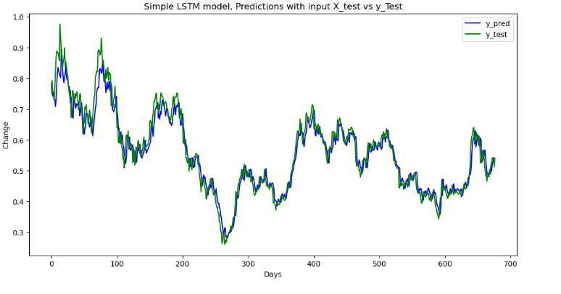
LSTM Model Predication
LSTM (Long Short-Term Memory) models are a type of RNN (Recurrent Neural Network) specifically designed to address the issue of long-term dependencies in sequential data.

Slide 9
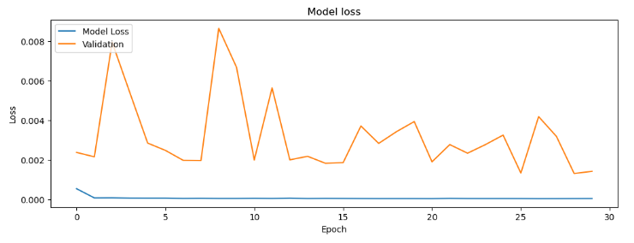
LSTM Model Loss vs Epoch

Slide 10

Why LSTM for Stock Prediction:
Capturing Temporal Dependencies: Stock prices are influenced by past trends, and LSTMs can effectively capture and utilize these dependencies.
Handling Non-Linear Relationships: LSTMs can model complex, non-linear relationships in stock data, which is often necessary for accurate predictions.
Mitigating Long-Term Dependency Issues: LSTM’s architecture allows it to remember important trends over long periods, which is crucial for stock price forecasting.

Slide 11
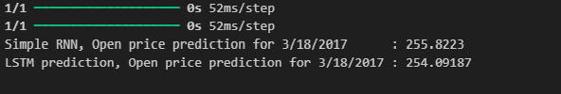
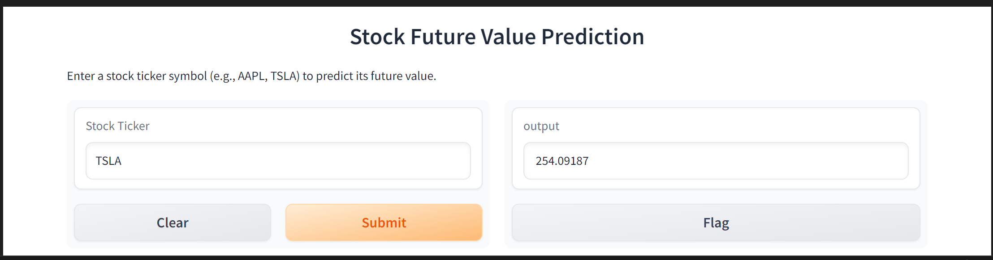
Predication Output & UI

Slide 12
Next Step
Add Septimal analysis as input parameter
Train the model run time for various tickers

